Slide 1
CarHop
Team 11
Emilian Dumea
Octavian Cojocariu

Slide 2
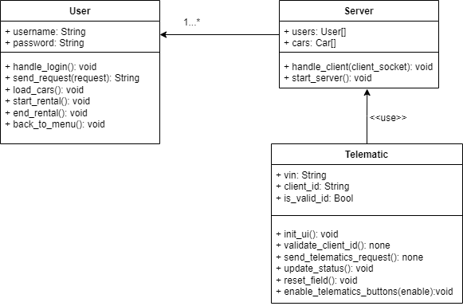
Entities – Class Diagram

Slide 3
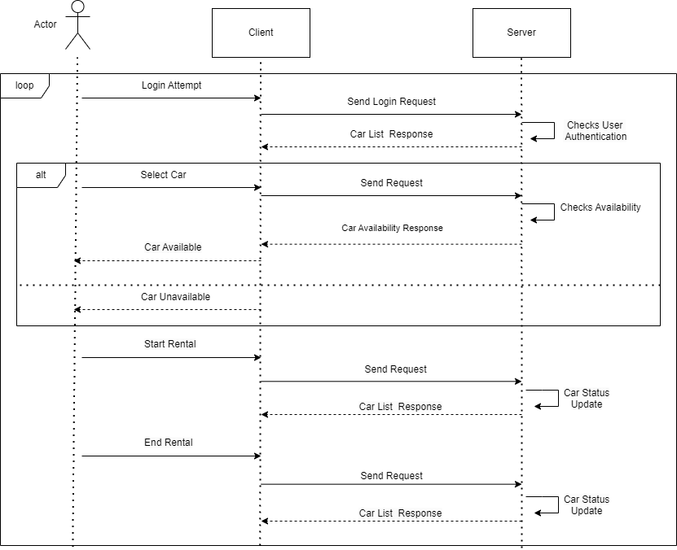
Communication Protocol – Sequence Diagram

Slide 4
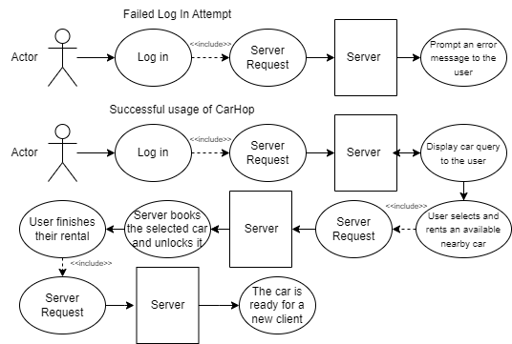
Flows for the use-cases – Flow Diagrams

Slide 5
Technologies used in implementation
demo application written in Python
used libraries : PyQt5, socket, json, threading
diagrams made using draw.io

